Slide 1
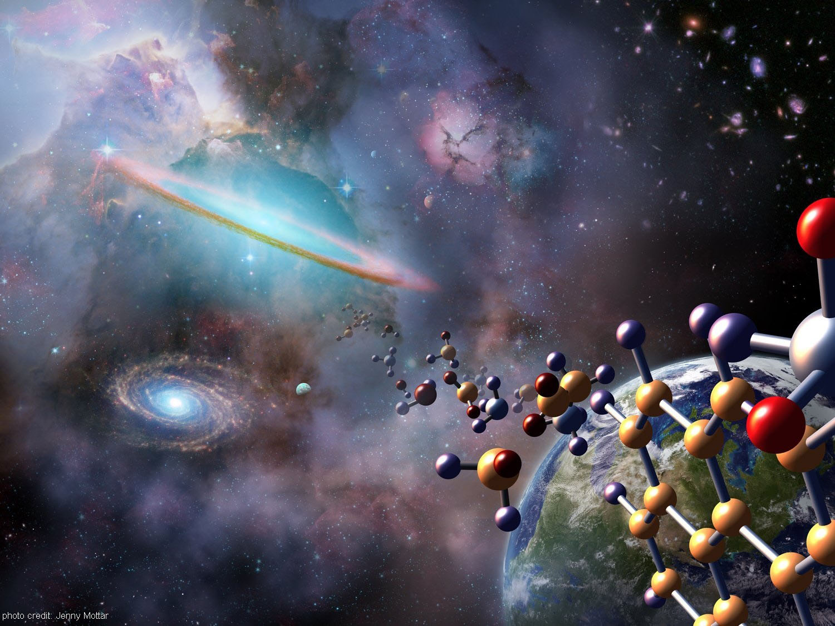
History of Life
By Andrew E Lyman-Buttler

Slide 2
Points:
Outline the modern scientific understanding of the formation of Earth
Summarize the concept of half-life
Describe the production of organic compounds in the Miller-Urey apparatus
Summarize the possible importance of cell-like structures produced in the laboratory
Explain the importance of the chemistry of RNA in relation to the origin of life
List three inferred characteristics that describe the first forms of cellular life on Earth
Compare the two types of autotrophy used by early cells
Relate the development of photosynthesis to the development of aerobic respiration in early cells
Explain the theory of endosymbiosis

Slide 3
The Big Question:
Cell theory: all cells come from cells
…so where did the first cell come from?

Slide 4
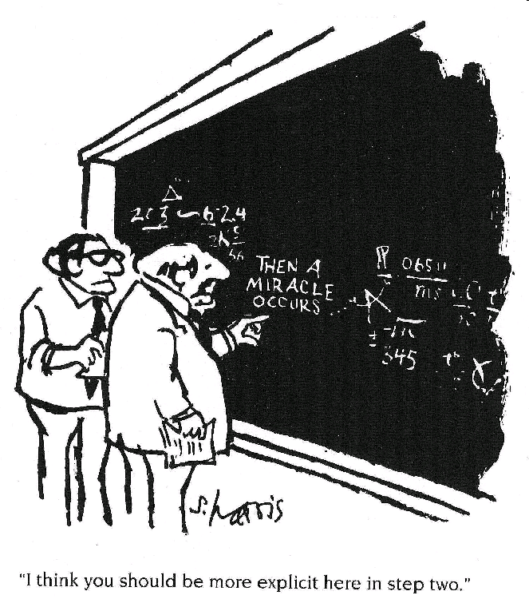
Scientists must seek natural explanations for natural phenomena. This is what sets science apart from other kinds of inquiry.
What does this mean?

Slide 5
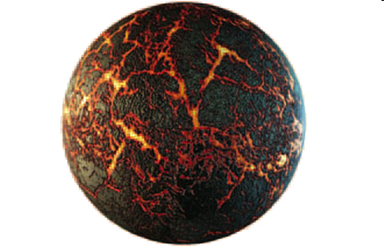
The formation of Earth
Accretion of huge gas and dust cloud → solar system
Accretion = colliding & sticking together (releases heat)
Most particles gathered in center, got so hot they began nuclear fusion → the Sun
Some particles orbited around the center → the planets
Meteor strikes very common on early Earth; kept it very hot
Eventually collisions stopped, surface cooled, and atmosphere formed
Water from volcanoes & comets made oceans

Slide 6

Earth’s age
Earth is about 4.6 billion years old
Earth has changed enormously during that time
The age of the earth is strongly supported by evidence:
Geological strata (layers of rock)
Radiometric dating: a chemical signature that can tell you how long ago something stopped exchanging atoms with its surroundings (e.g. a rock solidified, a tree died, etc.)

Slide 7
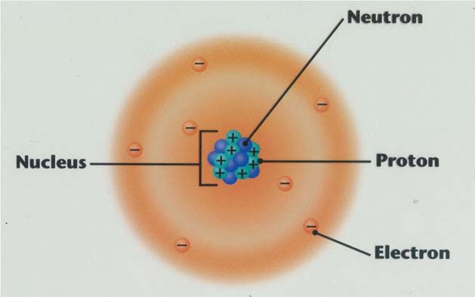
Radiometric dating
Atoms are made of protons and neutrons (the nucleus) and electrons (a cloud around the nucleus)
All atoms of an element have the same number of protons (e.g. all carbon atoms have 6 protons)
Different isotopes of an element have different numbers of neutrons

Slide 8
Radiometric dating
An atom’s mass number is the total number of protons plus neutrons
Carbon-12 and Carbon-14 are different ___ of carbon
Carbon-12 has ___ protons and ___ neutrons
Carbon-14 has ___ protons and ___ neutrons

Slide 9
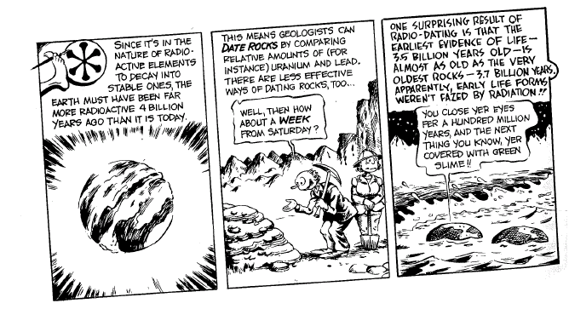
Radiometric dating
Some isotopes are radioactive isotopes—they decay into other, more stable elements because their nucleus is unstable
A half-life is how long it takes for ½ of any size sample of a radioactive isotope to decay to a stable form
Example: 8 g of carbon-14 decays to nitrogen-14; half-life is 5,800 years (what happens after 11,600 years?)

Slide 10
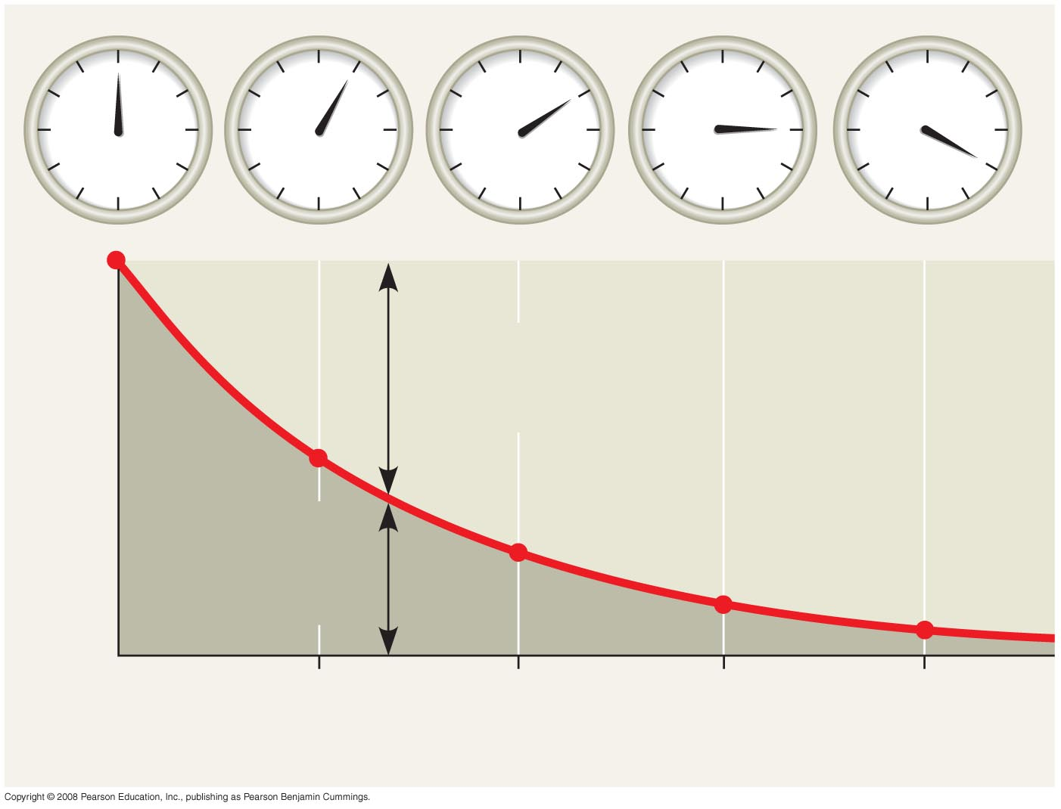
Fig. 25-5
Accumulating
“daughter”
isotope
Fraction of parent isotope remaining
¹/₂
Remaining
“parent”
isotope
¹/₄
¹/₈
¹/₁₆
1
2
3
4
Time (half-lives)
Notes:
Figure 25.5 Radiometric dating

Slide 11
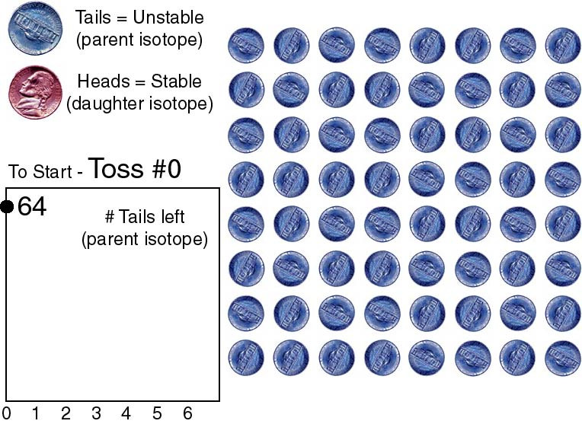

Slide 12
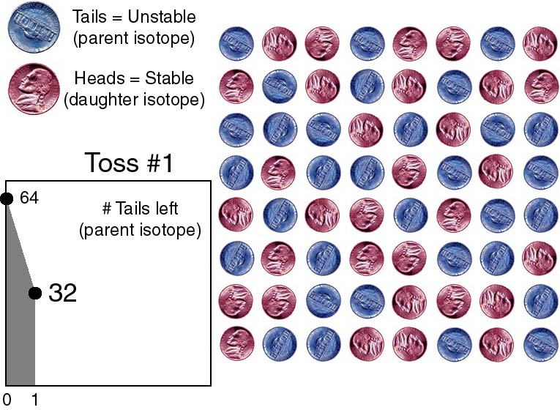

Slide 13
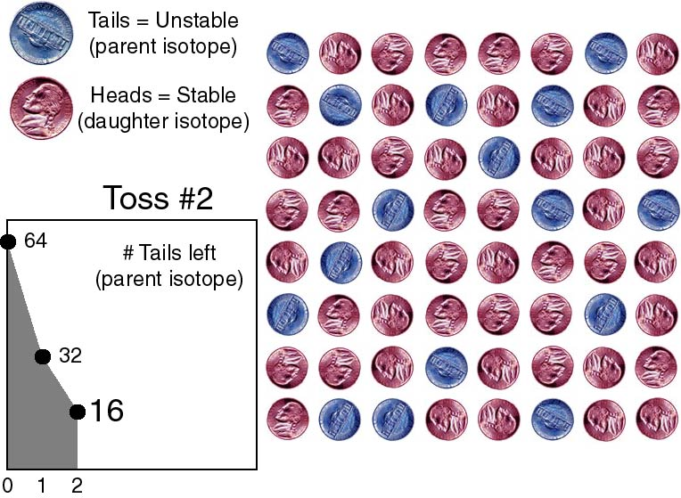

Slide 14
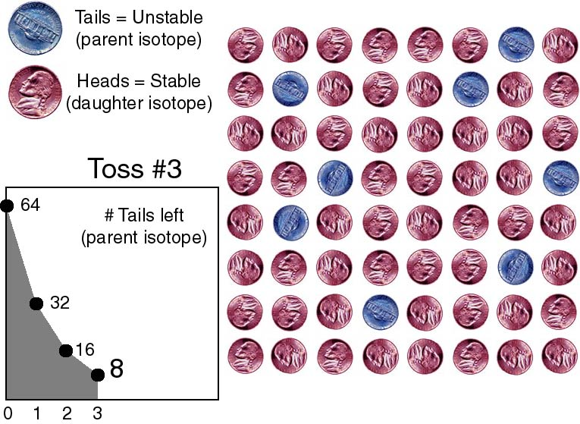

Slide 15
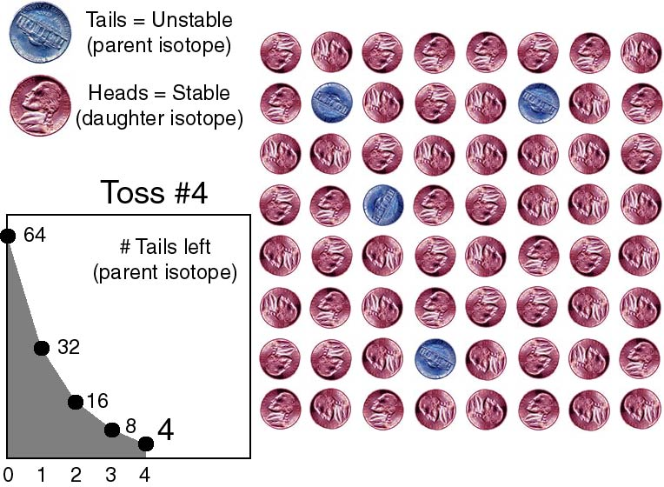

Slide 16
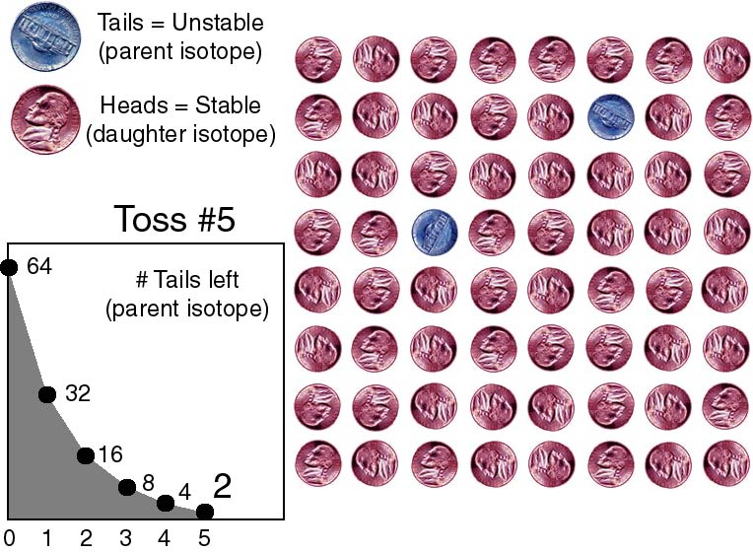

Slide 17
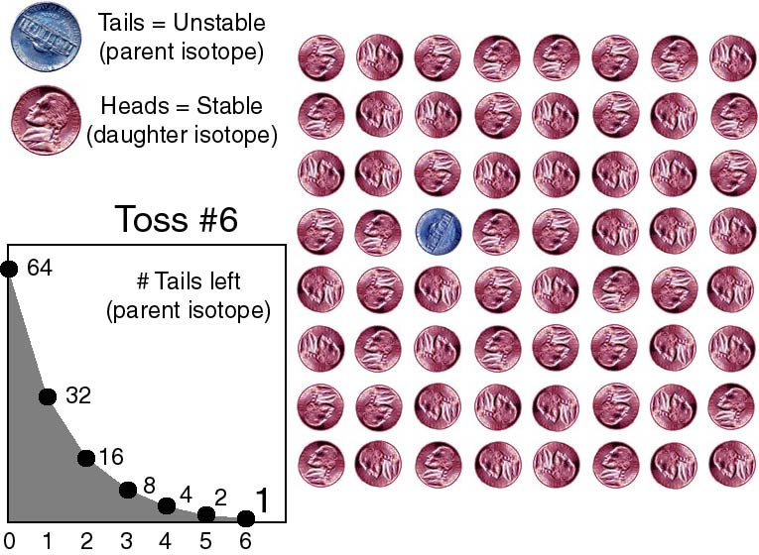

Slide 18


The origin of life
Four steps were needed to make the first cell:
1. The first organic (carbon) compounds
2. Joining of these small molecules into macromolecules
3. Packaging of molecules into membrane-bound structures
4. Origin of heredity (genetic material)
This soon led to the first text message:
OMMG it’s alive!
Look, it’s the first CELL!

Slide 19
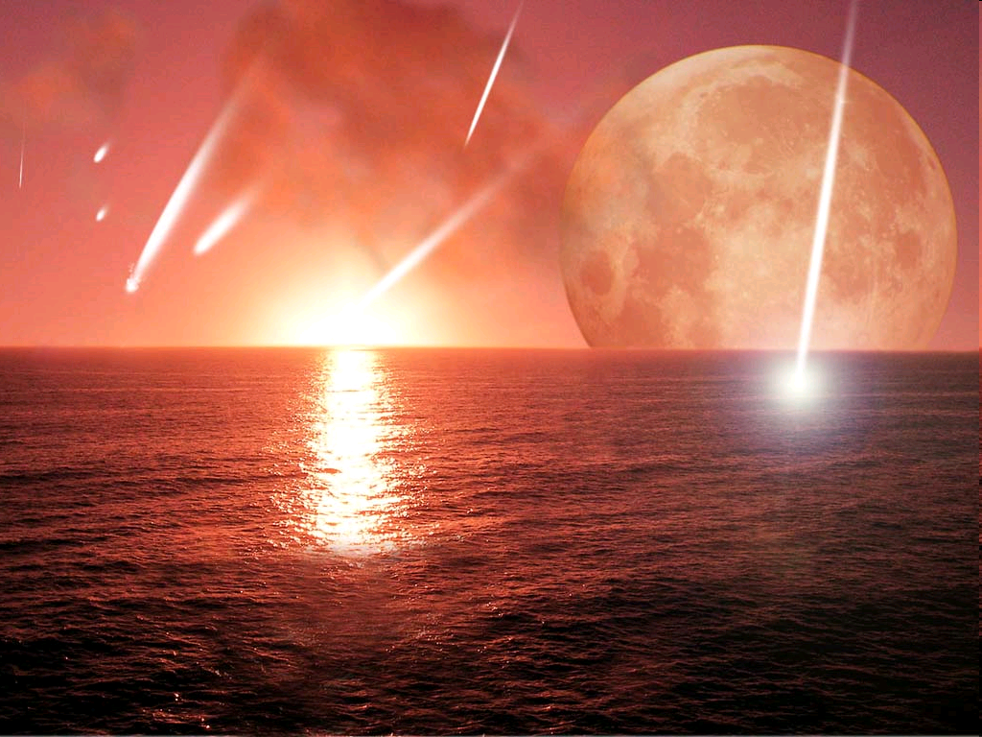
Welcome to Earth…4 billion years ago
sterile
hot
volcanic
When you think about it…these things could be sources of energy.
UV radiation
meteorites
storms & lightning

Slide 20
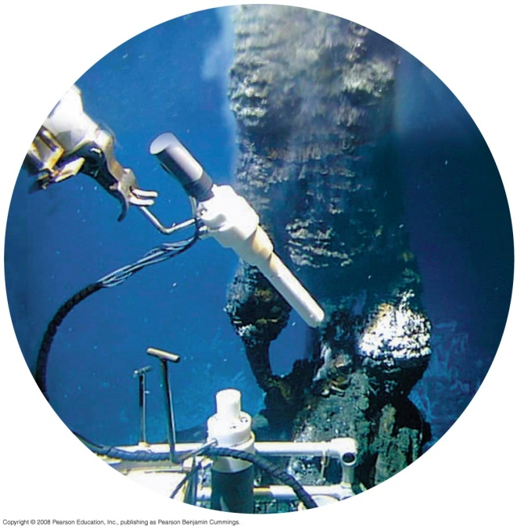
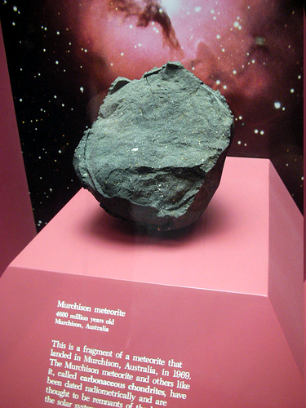
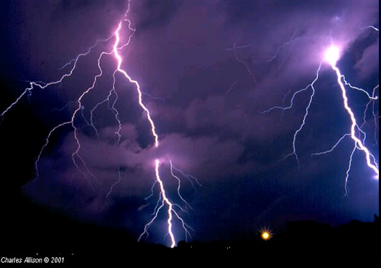
The first organic compounds: 3 hypotheses
Gases in early Earth’s atmosphere reacted to form simple organic compounds (Oparin/Miller/Urey)
They were made in deep sea vents (Wächtershäuser)
They came…from outer space!!! (panspermia)

Slide 21
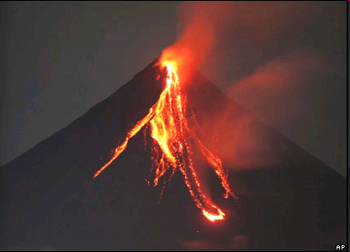
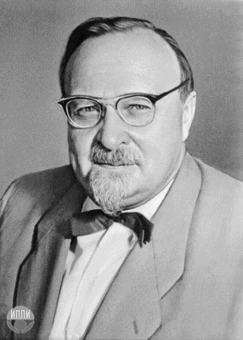
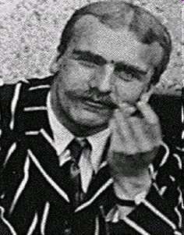
The Oparin-Haldane hypothesis
Early atmosphere came from volcanoes
WHAM!
Water
Hydrogen
Ammonia
Methane
NO OXYGEN!
Aleksandr Oparin and J. B. S. Haldane suggested in the 1920s that these small molecules could have formed more complex molecules under early Earth conditions.

Slide 22
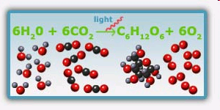
The Oparin-Haldane hypothesis
Remember, to go from small molecules to large ones, you need to make bonds…
which means you must PUT IN ENERGY somehow!
small small BIG
(photosynthesis is one example of this)

Slide 23
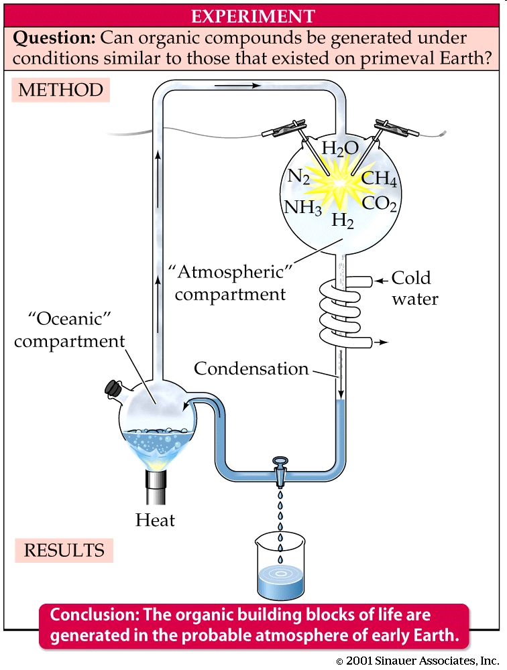
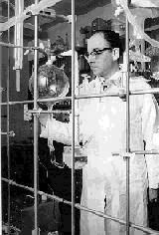
The Miller-Urey experiment (1953) tested the Oparin-Haldane hypothesis.

Slide 24
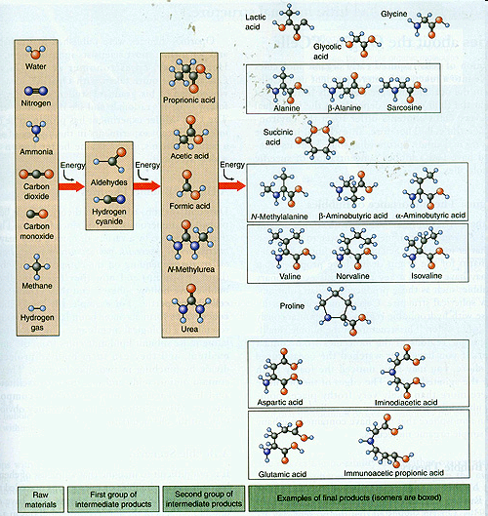
Results:
End: big, complex molecules
Start: small, simple molecules

Slide 25
Many scientists are not convinced that the early atmosphere was like the Miller-Urey experiment
Still important—showed that simple gases can make organic compounds on their own

Slide 26
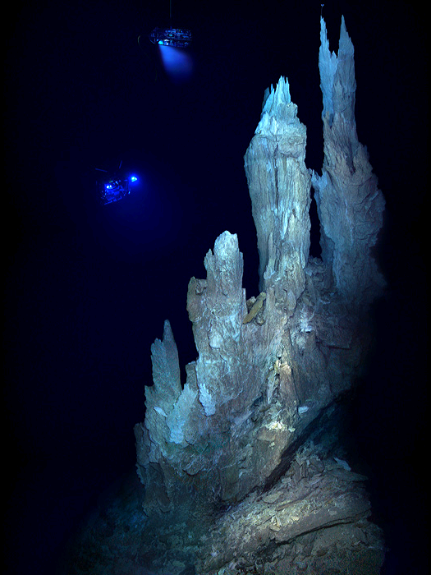
Deep sea vents?
Many deep sea hydrothermal vents (underwater hot springs) have chemistry similar to WHAM
Günter Wächtershäuser proposed in 1988 that organic compounds could be made there
This one → called the “Lost City” is of particular interest to scientists

Slide 27
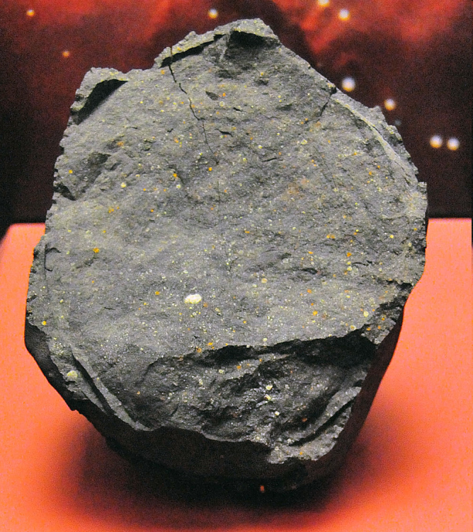
From outer space?
Organic compounds came to Earth on a meteorite
This hypothesis has less support than the first two
It is possible, though…in 1970 a meteorite containing amino acids and nitrogenous bases landed in Murchison, Australia

Slide 28
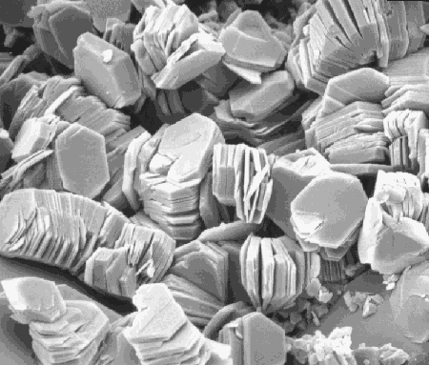
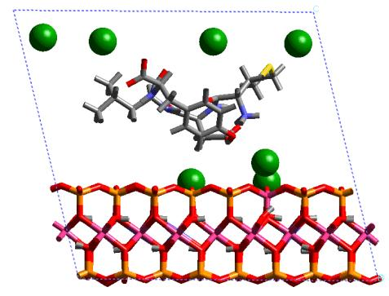
Macromolecules and Membranes
Macromolecules are polymers of simpler molecules
Clay mineral hypothesis:
Molecules bind to surface of clay minerals
Water evaporates, concentrating organic molecules
High concentration forces molecules → polymers

Slide 29
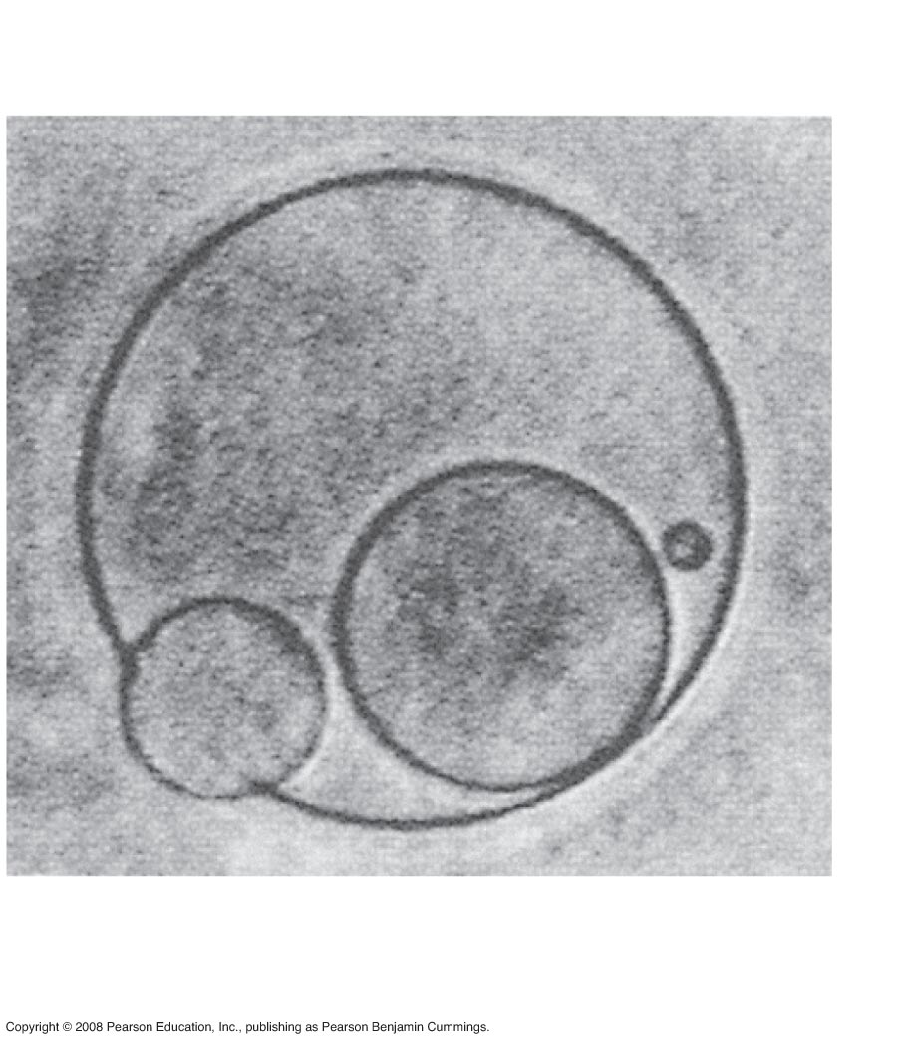
Macromolecules and Membranes
Microspheres and coacervates: basic membrane-bound chemical systems
Simple reproduction and metabolism; membrane provides stable internal environment
Experiments show these could have formed spontaneously from simpler organic compounds

Slide 30
The First Life-Forms

Slide 31
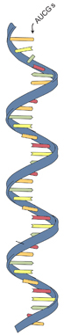
Genetics: the “RNA World” hypothesis
RNA carried out the basic functions of pre-living systems (this is widely accepted by scientists)
Evidence:
RNA can store genetic information in bases
Ribozymes (RNA enzymes) can catalyze some biochemical reactions (discovered by Tom Cech)
RNA can (under certain conditions) make copies of itself, or of other RNA molecules
Ribosomes are made of RNA
Sustained abiotic RNA synthesis not shown…yet

Slide 32
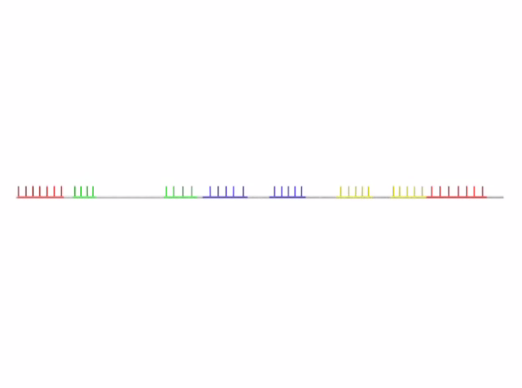
Genetics: the “RNA World” hypothesis
RNA can do all this because it is single-stranded, able to base pair with itself to make different structures (and structure → function)
Example: tRNA

Slide 33
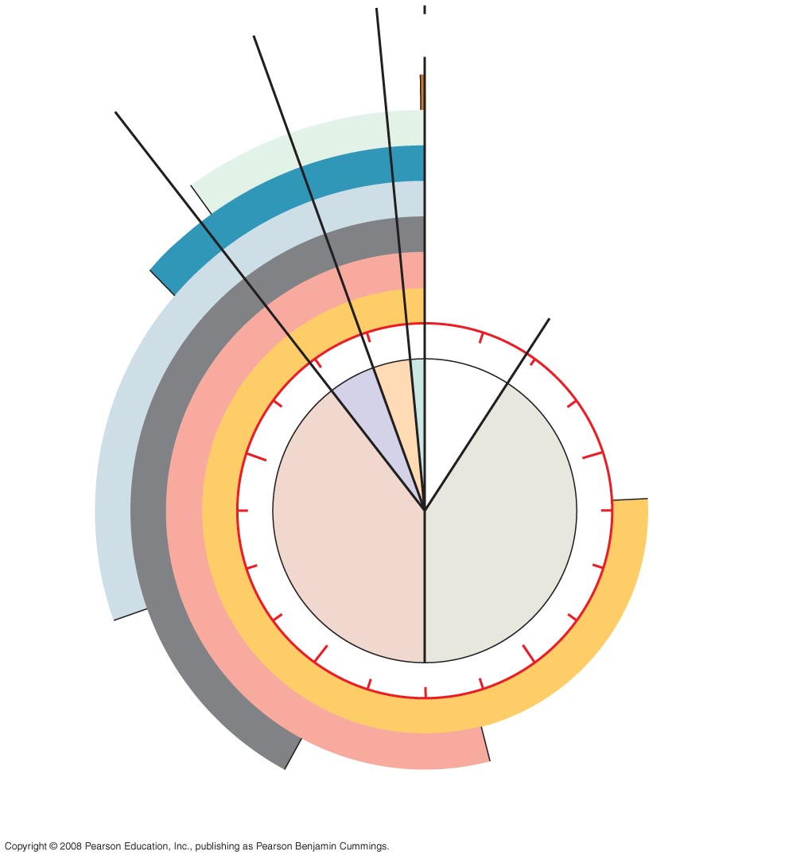
Fig. 25-7
Meso-
zoic
Ceno-
zoic
Paleozoic
Humans
Colonization
of land
Animals
Origin of solar
system and
Earth
1
4
Prokaryotes
Billions of
years ago
2
3
Multicellular
eukaryotes
Single-celled
eukaryotes
Atmospheric
oxygen
Notes:
Figure 25.7 Clock analogy for some key events in Earth’s history

Slide 34
The first cells
Inferred* characteristics:
Used anaerobic respiration (because atmosphere had no O₂)
Prokaryotic (because earliest fossil cells are prokaryotes)
Heterotrophic* (because the early environment had lots of organic molecules just floating around)
* to infer is to make a logical conclusion based on observations
* Heterotrophs do not make their own food

Slide 35
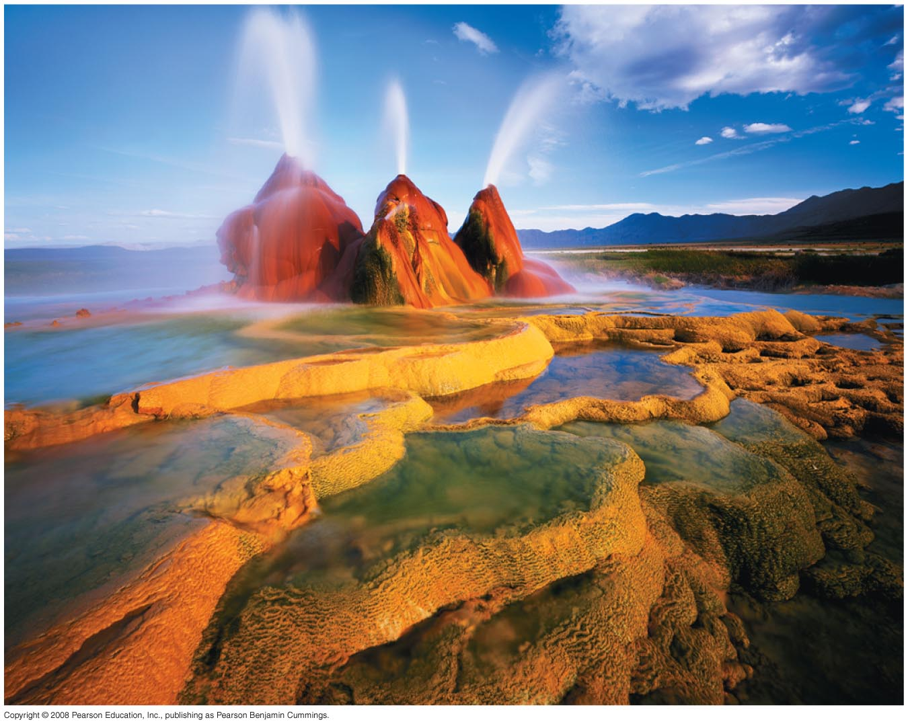
Chemosynthesis (Cs)
Early cells got energy from chemicals in the environment (chemosynthesis); Ps evolved later
Cs is widely used by modern archaea
Archaea are prokaryotic, single-celled organisms that often live in extreme environments (hot, salty, corrosive, etc.)
Studying archaea gives scientists clues about how metabolism might have worked in early cells
Cs and Ps are the 2 kinds of autotrophy

Slide 36
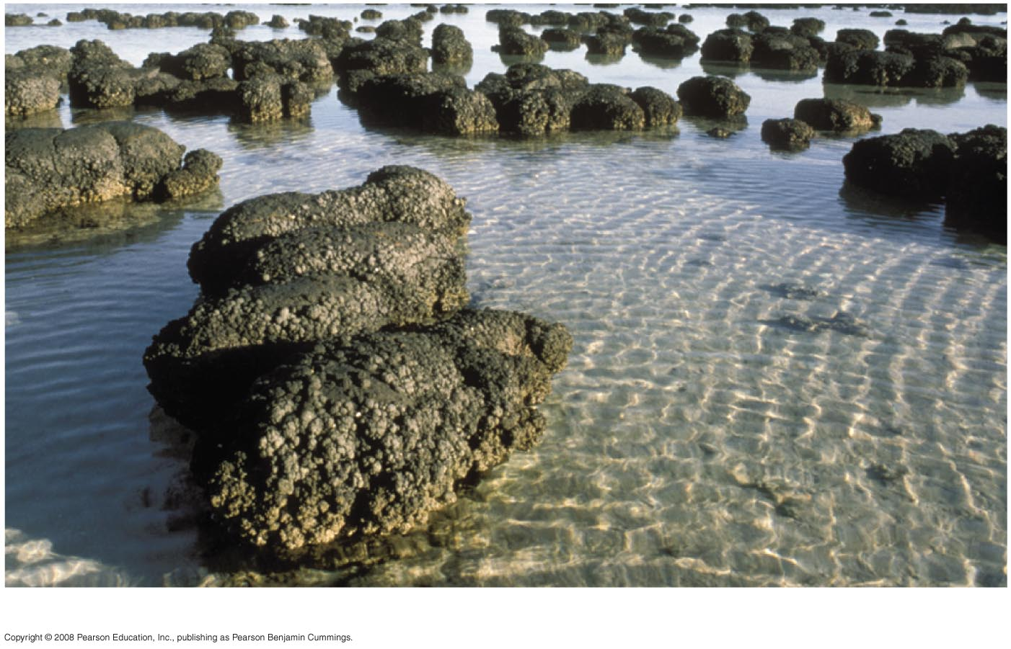
Photosynthesis and aerobic respiration
Cyanobacteria are photosynthetic bacteria
They grow in colonies and form huge fossils (stromatalites)
Oldest stromatalites are ~3.5 billion years old

Slide 37
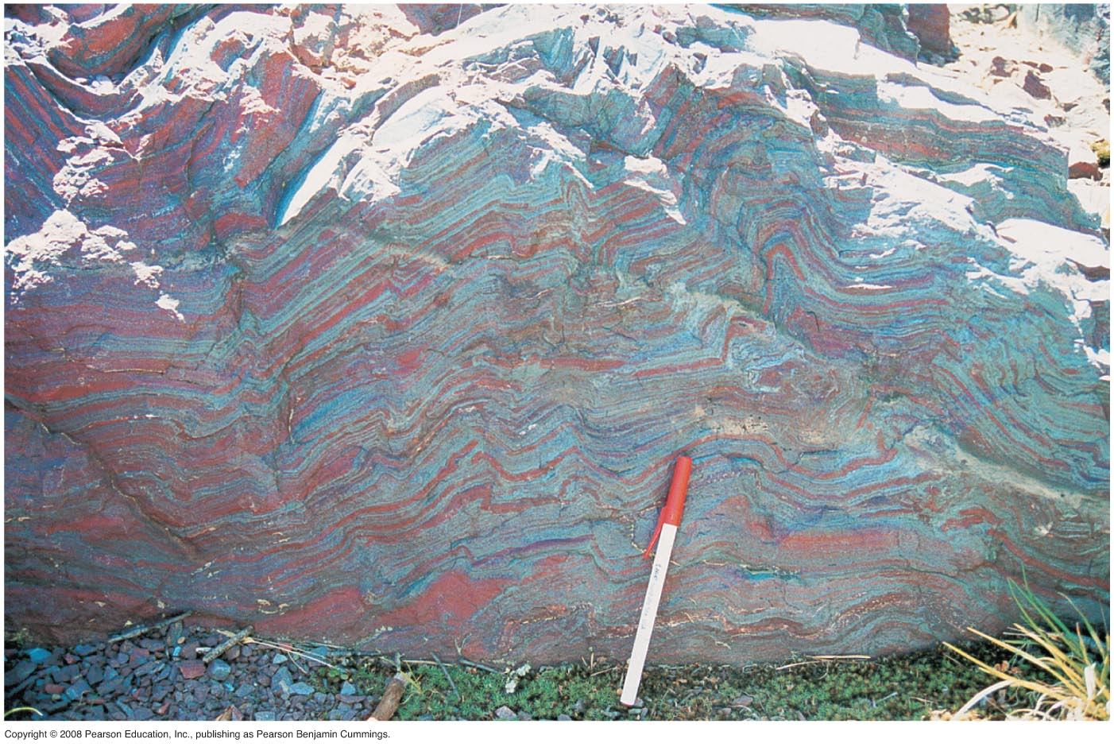
Photosynthesis (PS) and aerobic respiration
Evolution of PS added oxygen to atmosphere
O₂ allowed the evolution of aerobic respiration; also created ozone layer (blocks harmful UV) so life could move to land
Red = ???

Slide 38
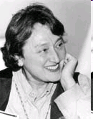
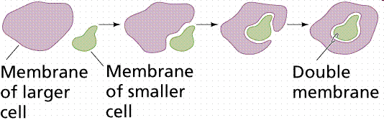
The first eukaryotes
In 1966, Lynn Margulis proposed endosymbiosis: mitochondria and chloroplasts evolved from one prokaryote engulfing a second one, which continued to live and reproduce inside
The “engulfed” cell got protection
The “engulfing” cell got energy
Evidence: mitochondria and chloroplasts have double membranes, divide independently, have their own DNA, DNA is circular

Slide 39
Points:
Outline the modern scientific understanding of the formation of Earth
Summarize the concept of half-life
Describe the production of organic compounds in the Miller-Urey apparatus
Summarize the possible importance of cell-like structures produced in the laboratory
Explain the importance of the chemistry of RNA in relation to the origin of life
List three inferred characteristics that describe the first forms of cellular life on Earth
Compare the two types of autotrophy used by early cells
Relate the development of photosynthesis to the development of aerobic respiration in early cells
Explain the theory of endosymbiosis

